Slide 1
Mini project
DYNAMIC PRICING PREDICITION FOR CABS
Presented by:
Thriveni Pegyapuram (19UK5A0509)
Nagavelli Manish Kumar (19UK5A0528)
N. Adithya Vardan (17UK105G6)

Slide 2
INTRODUCTION
Many organizations do not have a direct role in travel and tourism but offer related products and services. Some examples would be offering travel insurance, parking facilities at airports, theatre and event tickets, car hire, and travel by rail or coach to airports, etc. at competitive rates. There are various different forms of dynamic pricing:
1. Peak Pricing – This is a strategy that is common in transportation businesses. Airlines are a good example. Airlines often charge a higher price to travel during rush hour mostly on weekdays and sometimes on weekends.
2. Surge Pricing – Companies such as Uber respond dynamically to changes in supply and demand in order to price their services differently. Like most of us have noticed, this frequently happens on stormy evenings and nights when more people request for cabs. Taxify also not so long ago introduced dynamic pricing to ensure the drivers are encouraged to go online and offer services when the demand is high.

Slide 3
abstract
Every day the price of travel was changed due to the demand for public uses. The framework developed for the price prediction is analyzed for the travel plans. For the same travel plan offered at a fixed price for a particular group of customers, our proposed model saw a final fare with a lesser number of errors in predicting customer planning. As time progresses and more data are collected, the supervised learning will produce more accurate results and will be helpful in determining fare optimizer and dynamic availability of adjustments and continuously improve future recommendations.

Slide 4
Tools and technologies
Importing Libraries
import pandas as pd
import numpy as np
#standard visualization libraries
import matplotlib.pyplot as plt
import seaborn as sns
Importing Dataset
Dataset is collected from kaggle.com

Slide 5
Data processing
In this chapter, we discuss various applications and methods which inspired us to build our project.
We did a background survey regarding the basic ideas of our project and used those ideas for the collection of information like the technological stack, algorithms, and shortcomings of our project which led us to build a better project Predicting price of a used cars has been studied extensively in various researches discussed, in her paper written for Master thesis [2], that regression model that was built using Random Forest Regression can predict the price of a car that has been leased with better precision than multivariate regression or some simple multiple regression.
This is on the grounds that Random Forest Regression is better in dealing with datasets with more dimensions and it is less prone to overfitting and underfitting.

Slide 6
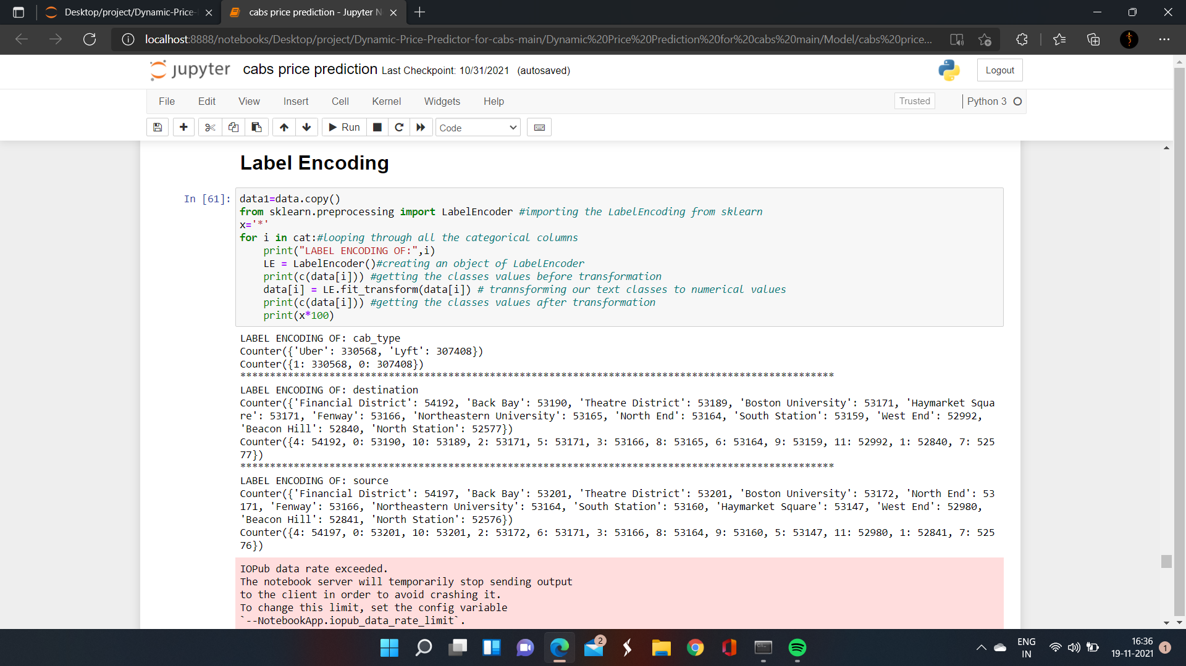
Label encoding

Slide 7
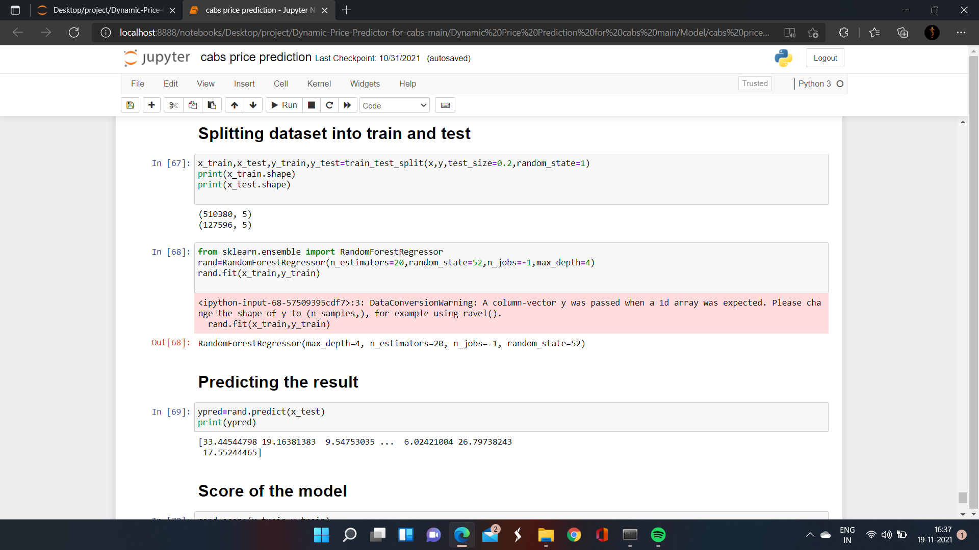
Train test split
Test dataset: using the input element from the training data the algorithm make predictions.
Performing machine learning models: Random Forest
Training data set: It is used to train the algorithm and fit the machine learning models of the performance of the models.
We used sklearn.ensemble module train_test_split which is used for training and testing part.
We used Random Forest Classifier for predicting Cabs Price Prediction.

Slide 8
CONCLUSION
Saving the model:
We saved our machine learning model using pickle.
Deployment using Flask:
In the end we want our model to be available for the end users. So the end user can use our model. Model deployment is one of the last stage in any machine learning project.

Slide 9
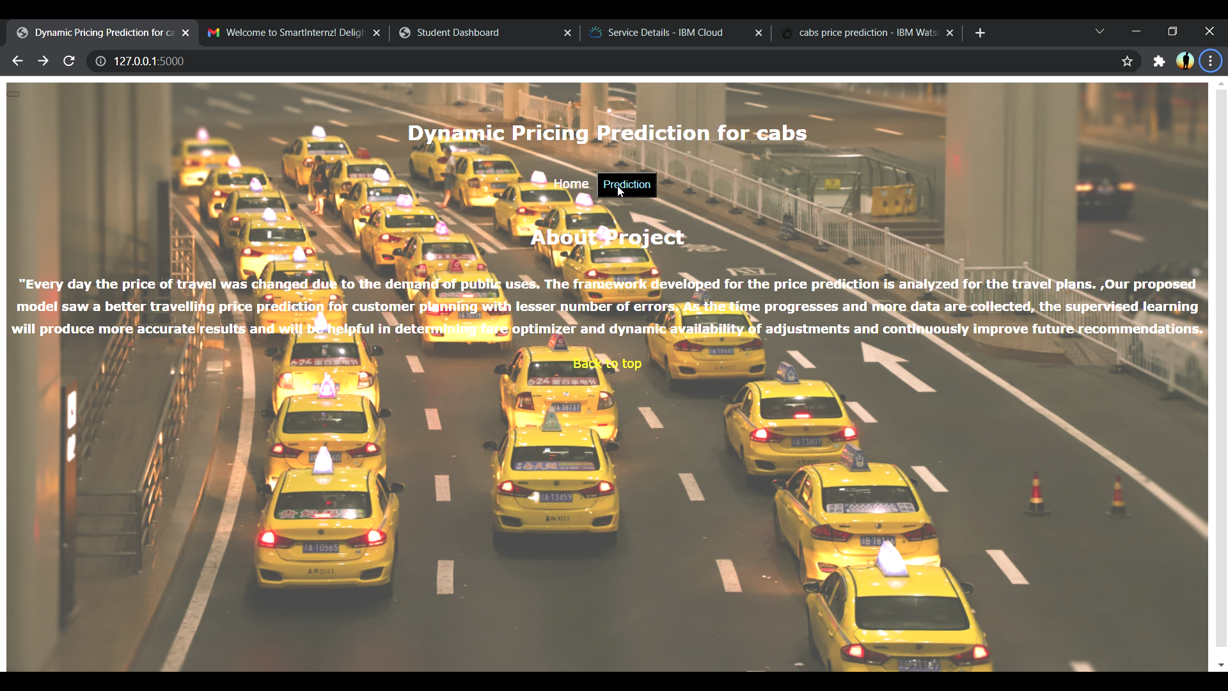
Our prediction output

Slide 10
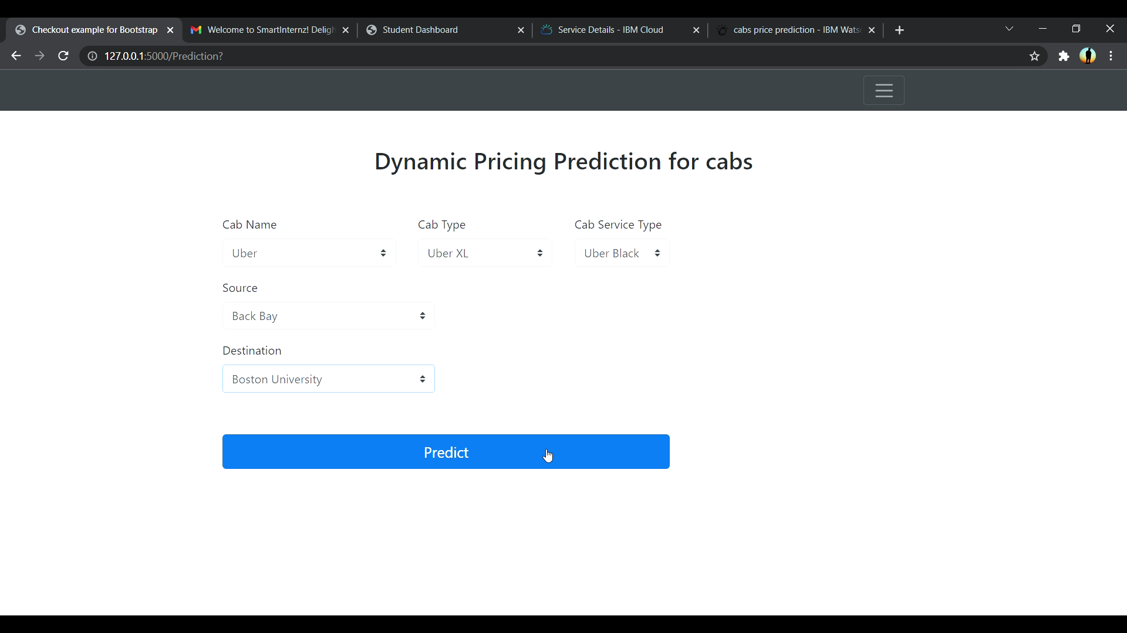
Prediction output

Slide 11
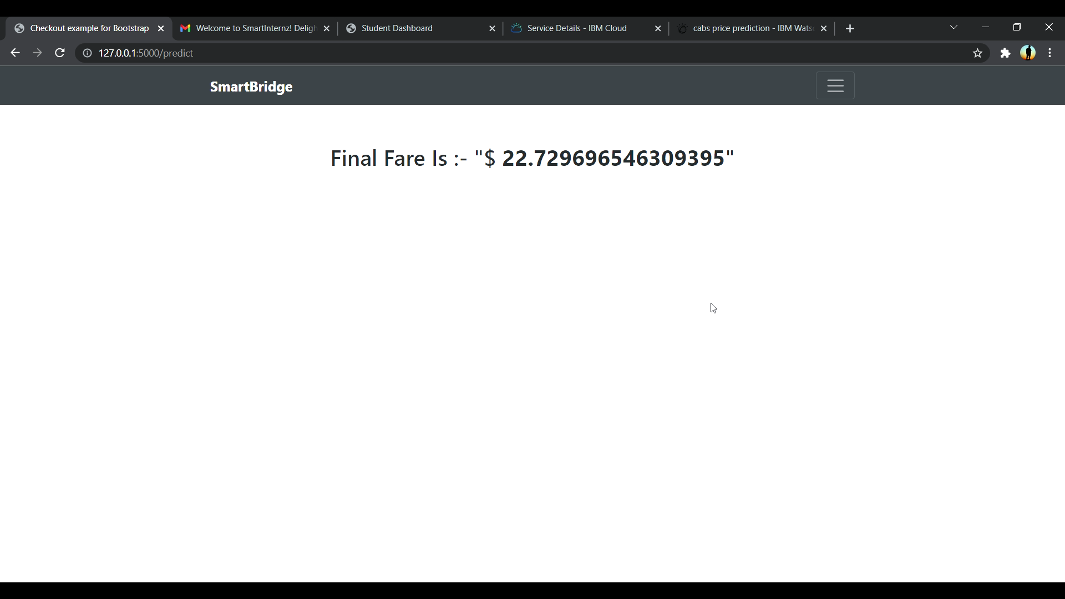
Estimate cab price

Slide 12


